Slide 1






YOUTH DATA
MENTAL HEALTH & SUBSTANCE USE
ACES, MENTAL HEALTH, GAMBLING,
TOBACCO & NICOTINE, UNDERAGE DRINKING, MARIJUANA & OPIOIDS
FEBRUARY 2022

Slide 2

ADVERSE CHILDHOOD EXPERIENCES
("ACEs")

Slide 3



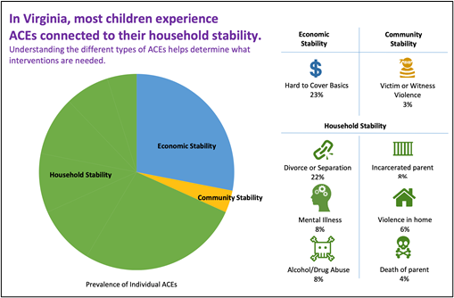

Source: Fact sheet, Campaign for a Trauma Informed
Virginia using data from Child Trends. (2018).
“The accumulation of multiple adverse childhood experiences (ACEs) is associated with a detrimental long-term impact on health and development.”
41% of children in Virginia have at least one ACE, 19% have experienced 2 or more, and 11% have experienced 3 or more.
The burden of ACEs is disproportionately borne by children who are Black and Latino.
The impact of ACEs can however be buffered by supportive family relationships and community interventions.
Traumatic childhood adversity is often a precursor to mental health issues later in life.

Slide 4
MENTAL HEALTH
(NATIONAL TRENDS)

Slide 5

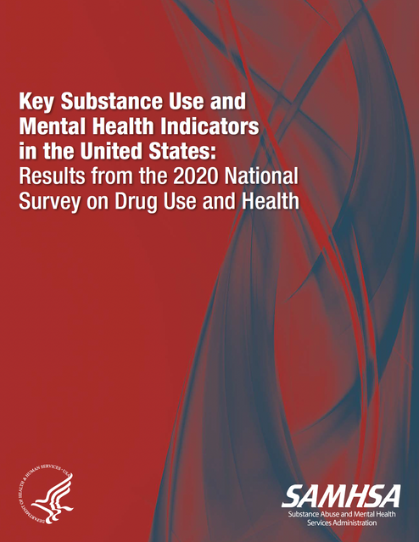
Among adolescents aged 12 to 17 in 2020, 17.0 percent (or 4.1 million people) had a past year major depressive episode (MDE), and 12.0 percent (or 2.9 million people) had a past year MDE with severe impairment.
Adolescents with mental health issues are more likely to binge alcohol or use illicit drugs, marijuana, tobacco or vape nicotine.
Among adolescents aged 12 to 17 in 2020, those with a past year MDE were more likely than adolescents without a past year MDE to be past year illicit drug users (28.6 vs. 10.7 percent) or past year marijuana users (22.0 vs. 7.9 percent).
image: Marina Gorskaya

Slide 6
MENTAL HEALTH
(SUICIDE &
SELF-HARM)

Slide 7




Suicide: National Data
About 5% or 12.2 million people aged 19 or older in the US had serious thoughts of suicide (2020).
Among young adults ages 18-25 11.3% or 3.8 million had serious thoughts of suicide, 4% made a plan,
and almost 2 % or 627000 people attempted suicide.
Among adolescents 12-17, 12% or 3 million had serious thoughts, 5.3% or 1.3 million made a plan, and 2.5 or 629,999 attempted suicide.

Slide 8
Females - Virginia
percent of deaths by suicide
Age 45+
11.8%
Age 25-44
18.4%
Age 10-19
51.3%
Age 20-24
18.4%
2019 Annual Report, Office of the Chief Medical Examiner

Slide 9
Males - Virginia
percent of deaths by suicide
Age 45+
16.5%
Age 10-19
27.5%
Age 25-44
23.1%
Age 20-24
33%
2019 Annual Report, Office of the Chief Medical Examiner

Slide 10
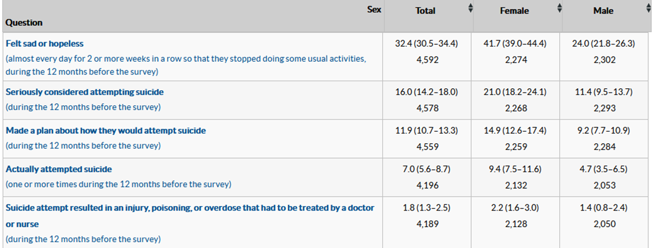
•In 2019, 32.4 % of high school students reported feeling so sad or hopeless almost every day for 2 weeks in a row that they stopped doing usual activities (42 % of females and 24% of males).
•16% seriously considered attempting suicide during the 12 months prior to the survey (21% of females and 11.4% of males)
•111.9% made a plan and 7% attempted suicide.
Suicide:
State Data
on Youth
9th -12th Grades: High School Youth Risk Behavior Survey 2019, CDC

Slide 11
GAMBLING

Slide 12
Youth & Young Adult Gambling
Myth: Adolescents cannot develop gambling problems.
Past national prevalence studies have found higher rates of gambling problems among adolescents than in the adult population. Anywhere from 2% to 7% of young people experience a gambling disorder (2008)
International Center for Responsible Gaming
Currently there is no available data on youth problem gambling in Virginia.
Efforts are underway to include questions related
to youth gambling on Virginia youth surveys.

Slide 13
TOBACCO (NICOTINE) USE

Slide 14

National Trends
The rate of nicotine vaping increases as teens advance through high school.
In 2020, 34.5% of 12th graders, 30.7% of 10th graders and 16.5% of 8th graders reported vaping within the past 12 months.
Nicotine vaping is more common among college youth than non-college youth.
Approximately one-fifth of young adults vape.
National Institutes of Drug Abuse, Monitoring the Future 2020 Survey Results

Slide 15
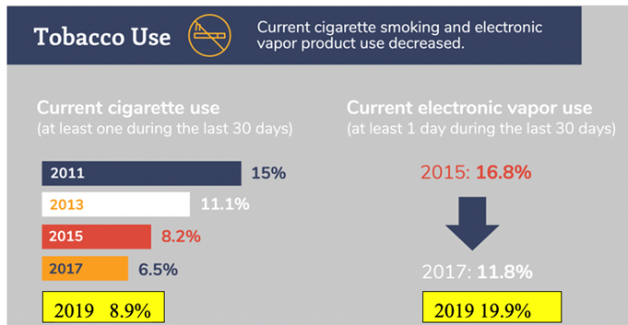
State Trends
The 2019 Virginia Youth Survey shows 2019 as a year that both cigarette usage and vaping increased
among middle and high school teens.
The Virginia Youth Survey is a biennial survey of Virginia middle and high schoolers. The 2021 survey is underway (Fall 2021) but the results are not available at the time of this presentation.

Slide 16
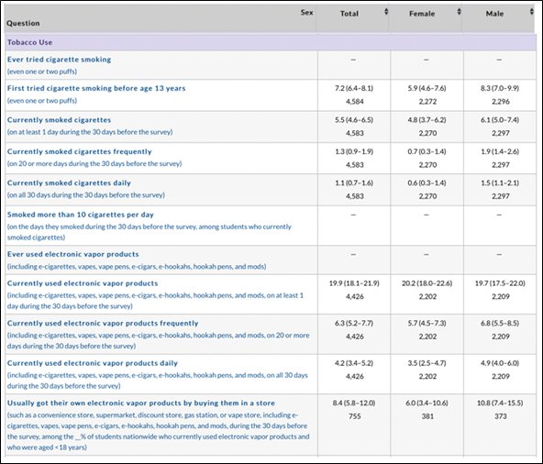
State
Trends
5.5% of high school students smoked cigarettes within the prior month and 20% used electronic vapor products within the last month.
2019 CDC Virginia High School Youth Risk Behavior Survey

Slide 17
UNDERAGE DRINKING

Slide 18
National Trends: Alcohol
In 2020,
20.5%, or 1 out of 5 8th graders
40.7% of 10th graders
55.3% of 12th graders
reported using alcohol within the past year.
As alarming as this may be, underage drinking prevention was working!
The 2020 rates were a significant reduction from 2010 reports of
29.3% of 8th graders
52.1% of 10th graders
65.2% of 12th graders
using alcohol within the past year.
Still unfolding are the impacts on youth alcohol use
of the COVID-19 pandemic that began in 2020.
National Institutes of Drug Abuse, Monitoring the Future 2020 Survey Results

Slide 19
National Trends
Excessive drinking does occur frequently among youth.
While there was a gradual decline in alcohol use between 2010 and 2020,
16.8% of 12th graders
9.6% of 10th graders and
4.6% of 8th graders
binge drink
In the context of this 2020 data,
binge drinking refers to consuming five or more drinks in a row
at some time within the past 2 weeks
National Institutes of Drug Abuse, Monitoring the Future 2020 Survey Results

Slide 20
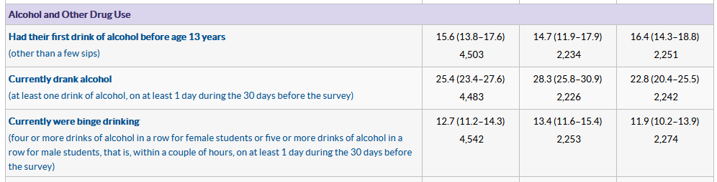
State Trends
- 1 out of 4 (25.4%) high school students drank alcohol on at least one day in the past month.
- 1 out of 8 (12.7%) high school students engaged in binge drinking during the past month.
CDC High School Youth Risk Behavior Survey, 9th-12th grade, Virginia, 2019

Slide 21
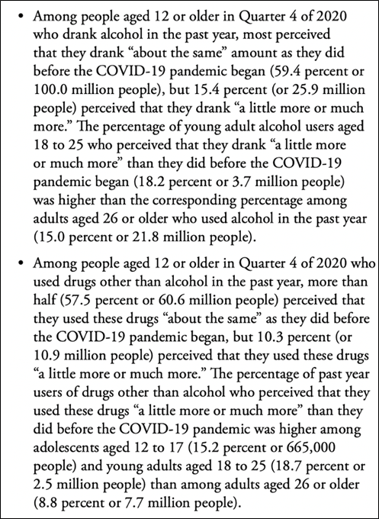
National Trends
Key Substance Use and Mental Health Indicators in the United States: Results from the 2020 National Survey on Drug Use and Health
The COVID-19 pandemic contributed to reported increases in alcohol and drug use.

Slide 22
MARIJUANA

Slide 23
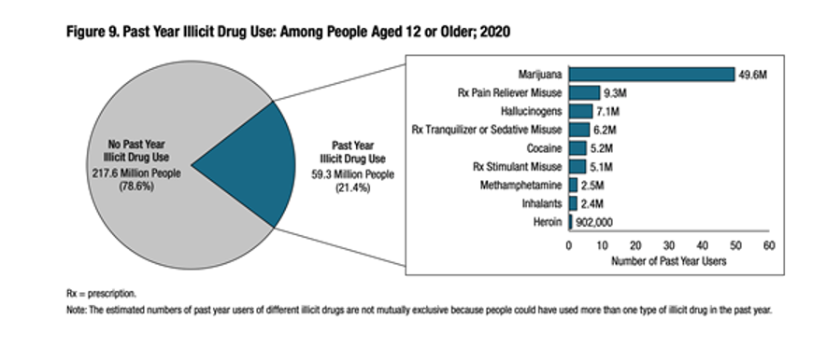
National Trends
1 out of 5 people aged 12 or older in the US engaged in past year illicit drug use, with 84 percent of those reporting using Marijuana.
Key Substance Use and Mental Health Indicators in the United States: Results from the 2020 National Survey on Drug Use and Health

Slide 24
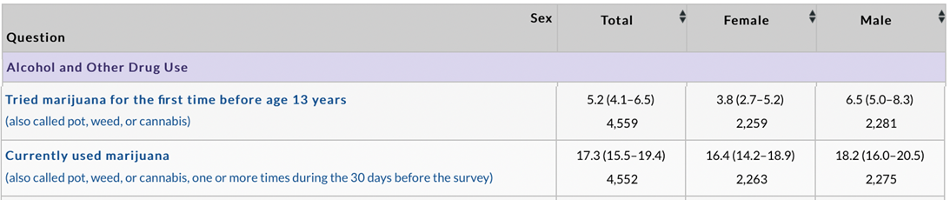
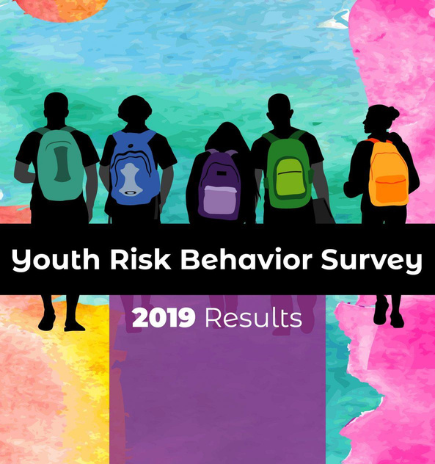
State Trends
17% of Virginia high school students currently use marijuana (2019).
9th -12th Grades: High School Youth Risk Behavior Survey 2019, CDC
Notes:
•A much smaller percentage of youth report daily marijuana use than reported having used or tried marijuana at some point in the past year.
•35% of 12th graders, 28% of 10th graders, and 11.4% of 8th graders have used marijuana in the past year.
•6.9% of 12th graders, 4.4% of 10th graders, and 1.1% of 8th graders use marijuana on a daily basis.
•Vaping of marijuana occurs less frequently than smoking marijuana.
•The percentage of teens who vaped marijuana in the past 12 months increased slightly between 2019 and 2020 after a marked increase from 2017.
•In 2020, 8% of 8th graders, 19% of 10th graders, and 22% of 12th graders reported that they vaped marijuana in the past 12 months.
•The percentage of 10th graders reporting daily, or near-daily, marijuana vaping decreased significantly between 2019 and 2020.
•Less than 1% of 8th graders, 1.7% of 10th graders and 2.5% of 12th graders report daily or near daily vaping of marijuana in 2020 compared to .8% of 8th graders, 3% of 10th graders and 3.5 % of 12th graders in 2019.

Slide 25
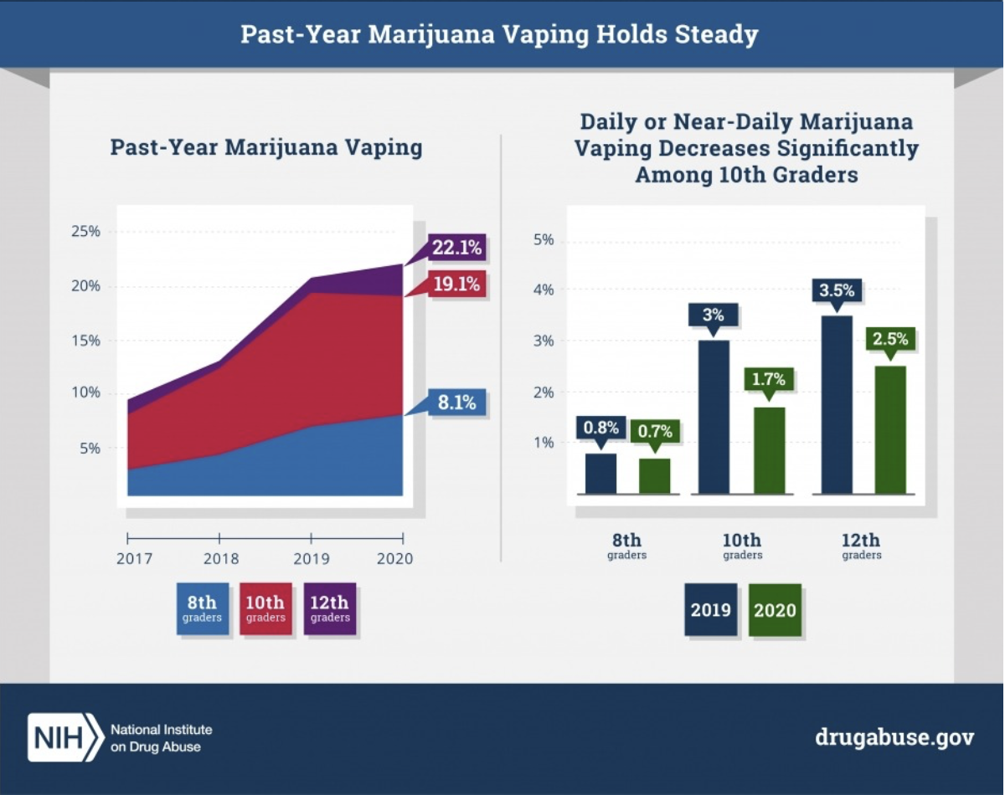
National Youth Marijuana Use Data
2020 Monitoring the Future Survey (NIDA):
•The percentage of teens who vaped marijuana in the past 12 months increased slightly between 2019 and 2020 after a marked increase from 2017.
•In 2020, 8.1% of 8th graders, 19.1% of 10th graders, and 22.1% of 12th graders reported that they vaped marijuana in the past 12 months.
•The percentage of 10th graders reporting daily or near-daily marijuana vaping decreased significantly between 2019 and 2020.
•Less than 1% of 8th graders, 1.7% of 10th graders and 2.5% of 12th graders report daily or near daily vaping of marijuana
in 2020 compared to .8% of 8th graders, 3% of 10th graders and 3.5 % of 12th graders in 2019.

Slide 26
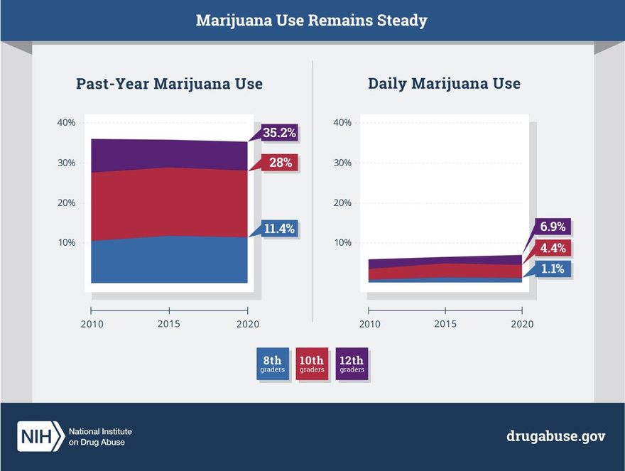
National
Youth Marijuana Use Data
2020 Monitoring the Future Survey (NIDA):
•35% of 12th graders, 28% of 10th graders, and 11.4% of 8th graders have used marijuana in the past year. •6.9% of 12th graders, 4.4% of 10th graders, and 1.1% of 8th graders, use marijuana on a daily basis.

Slide 27
OPIOIDS

Slide 28
National Trends
Key Substance Use and Mental Health Indicators in the United States: Results from the 2020 National Survey on Drug Use and Health
In 2020, 902,000 people 12 or older reported using heroin and 9.3 million reported misusing prescription pain relievers within the the past 12 months.
Prescription pain relievers were the second most used drug
among those reporting illicit drug use within the past 12 months.

Slide 29
National Trends
https://www.washingtonpost.com/health/2021/11/17/overdose-deaths-pandemic-fentanyl/
Exacerbated by the COVID-19 pandemic, opioid deaths in the US have escalated to historic proportions.
While 49,860 deaths were reported in the national vitals statistics system for the entire 12 months of 2019, the number of deaths more than doubled (100,000) in the 12-month period ending in April 2021.

Slide 30
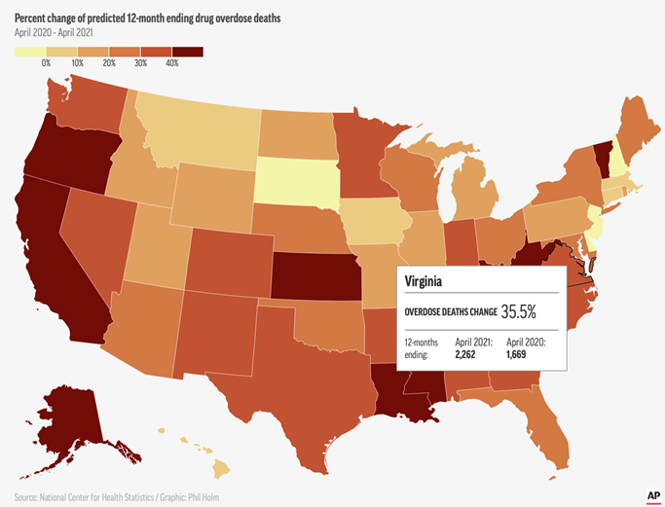
State Trends
Past 12-month overdose deaths in Virginia increased by 35.5% between 2020 and 2021.
National Center for Health Statistics,
https://www.washingtonpost.com/health/2021/11/17/overdose-deaths-pandemic-fentanyl/

Slide 31
Conclusions

Slide 32

POOR MENTAL HEALTH AND SUBSTANCE MISUSE CONTINUE TO BE PROBLEMATIC FOR YOUTH
-
AT A TIME WHEN THERE IS INCREASED SOCIAL ACCEPTABILITY AROUND ALCOHOL, MARIJUANA AND OTHER DRUG USE.
School-based prevention education is critical for ensuring young people maximize their health and well-being potential.

